Slide 1
BDTI Pilot miglierina

Slide 2
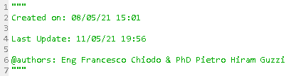
Data production
We used the data production of a 6KW/h system placed on the roof of an house in Miglierina.

Slide 3
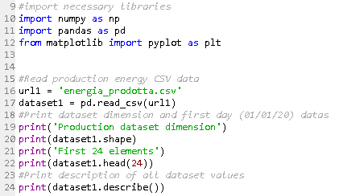
Data production csv script

Slide 4
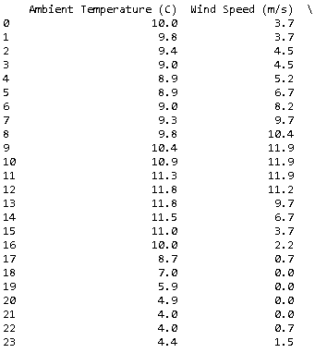
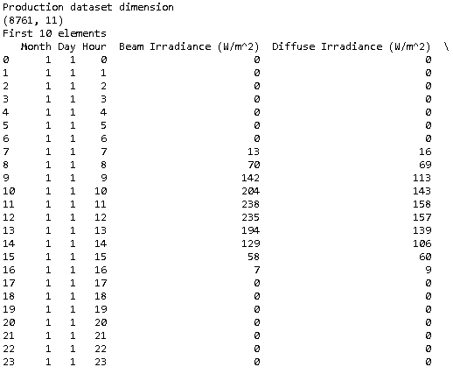
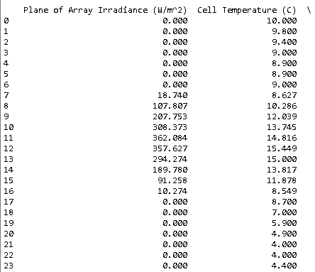
Results

Slide 5
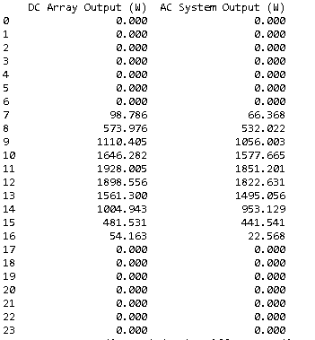
Energy production

Slide 6
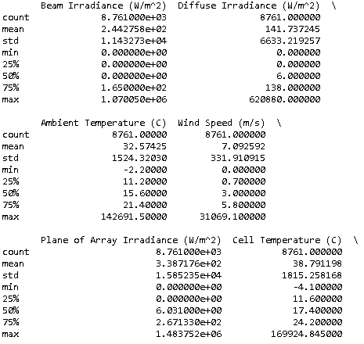
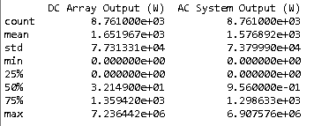
Output data description

Slide 7
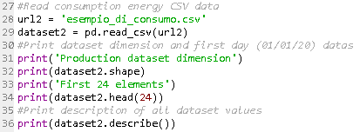
Data production study case script
It is an easier dataset than the consumption dataset, because we need to know only month, day, hour and kw consumed.

Slide 8
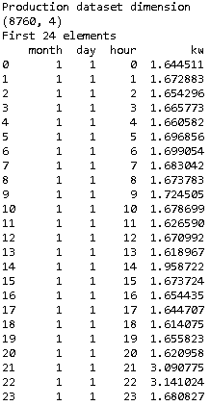
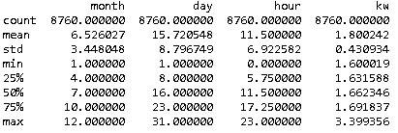
Results and data description

Slide 9

Data cleaning example
With this script we delete all the row with NaN Value, because, for example, a mean value sostitution can create problems for machine learning process.

Slide 10

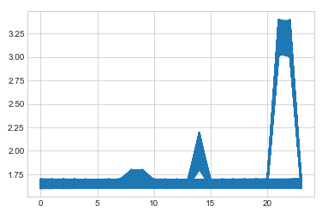
Data consumption (hour)

Slide 11

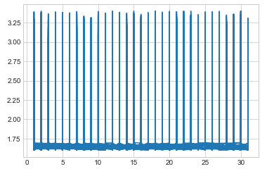
Data consumption (day)

Slide 12

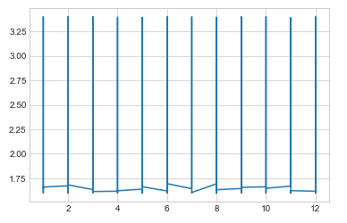
Data consumption (month)

